Slide 1
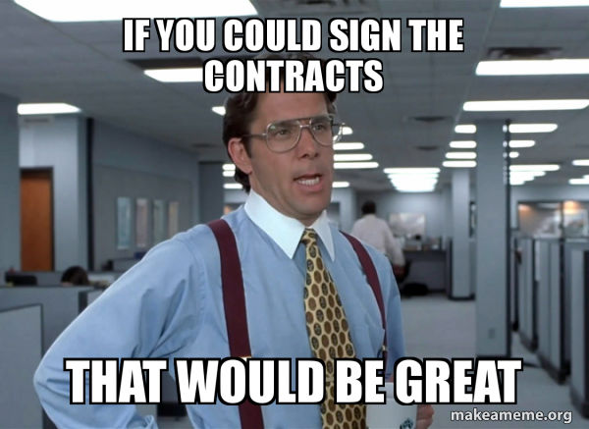
Contracts 101 How to Navigate Contracts
Cardice Howard Deputy Director, RESNET

Slide 2
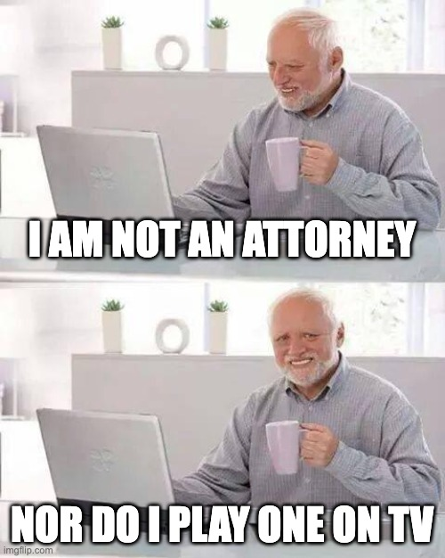
FULL DISCLAIMER

Slide 3
Why are we doing this session?
Again, I AM NOT A LAWYER.
The construction industry is viable for the overall economy.
We have a housing shortage.
Our industry is ever-evolving, it has a lot of moving parts and a lot of players.
A handshake will not get us what it used to get us.
Let’s practice better business practices to protect our businesses and our employees.

Slide 4
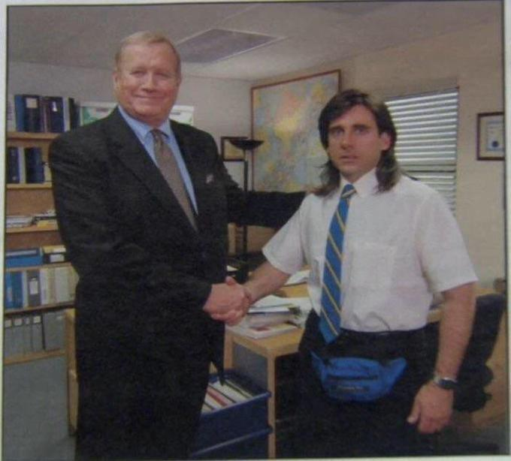
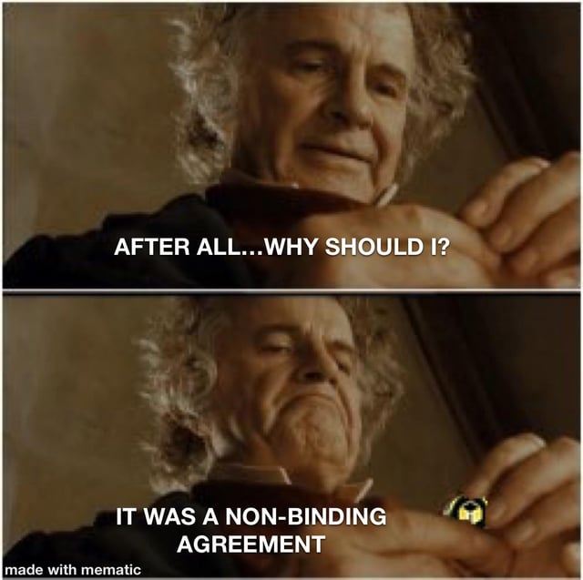
Better Business Practices / Let’s Contract

Slide 5
Why do we need CONTRACTS?
Clarity and Expectations: Contracts clearly outline the terms and conditions of an agreement, ensuring all parties understand their obligations and expectations.
Legal Protection: They provide legal protection by defining the rights and responsibilities of each party, which can be enforced in a court of law if necessary.
Risk Mitigation: Contracts help mitigate risks by addressing potential issues and conflicts in advance, reducing the likelihood of disputes.
Trust and Reliability: Having a written agreement builds trust and reliability between parties, as it demonstrates a commitment to the terms agreed upon.
Record of Commitments: They serve as a formal record of commitments, which can be referred to in case of any misunderstandings or disputes.
Operational Efficiency: Clearly defined roles, timelines, and payment conditions improve operational efficiency and ensure smooth business transactions.
Contracts are fundamental in establishing and maintaining strong business relationships

Slide 6
What is a CONTRACT???
What is a Business Contract?
A Business Contract is a legally binding agreement that lays out terms for the sale of goods or services between two companies/parties.
Business Contracts typically list what products or services are being sold and the price for each, as well as additional terms such as conditions, warranties, timelines, and payments.

Slide 7
When should you use a Business Contract?
Your business plans to buy or sell physical products from another business.
Your business will provide a service or receive a service from another business.
You are an individual or independent contractor who wants to make a formal business agreement.

Slide 8
What are the basic clauses for a business contract??
Parties of the contracts – NAMES
Effective dates of the contracts- BEGINNING AND ENDING
Scope of Work – SOW (what I am going to do)
What I am not going to do!
Fee structure – what will this cost you.
Payment plan – when do I expect to get paid!
Signatures – Execute the contract, NOW WE CAN GET TO WORK!

Slide 9
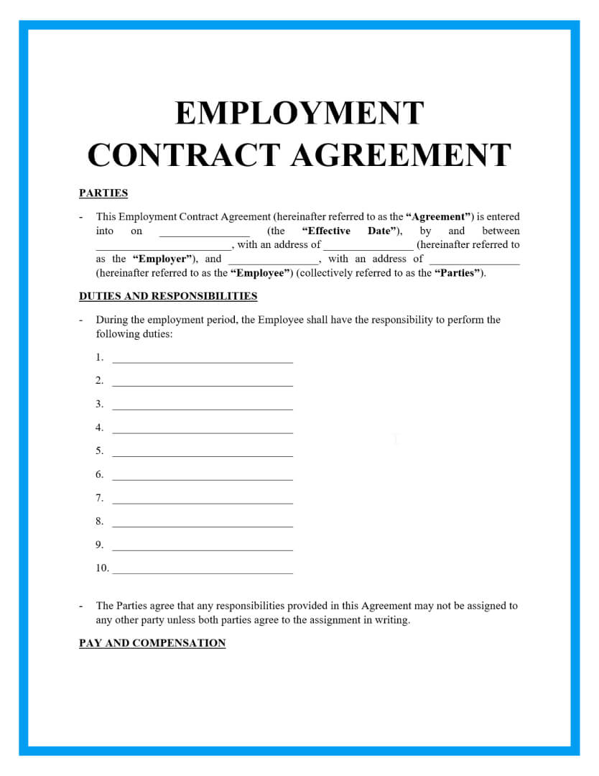
Basic Contract

Slide 10
Other clauses for a contract…… the weeds
Delivery of service – when am I expected to show up?
Payment of taxes – each party is usually responsible for their own taxes.
Warranties – call backs
Terms – how can I get out of this?
Default – I have not been paid or I did not deliver on time, what now?
Dispute resolution – Builder and Contractor not on the same page, how do we resolve?

Slide 11
The weeds – part 2
Confidentiality
Amendments – one or both parties want to change the original agreement/contract
Applicable law – what state’s law applies to this contract?
AND THERE COULD BE MORE

Slide 12
CONTRACTING PARTIES
Builder Name
Full legal name
Try to stay away from
The division name (unless approved by the builder)
The project name
Builder Type
Custom
Volume Builder
Multi Family

Slide 13
Contracting parties
Builder Business Structure
Corporation
Limited Liability Company (LLC)
Sole Proprietor
Partnership
These are the 4 most common business types.
Always be clear on your business type on your contracts.

Slide 14
Contracting Parties
Contractor Business Structure – Provider / Rater
Corporation
Limited Liability Company (LLC)
Sole Proprietor
Partnership
4 most common business types

Slide 15
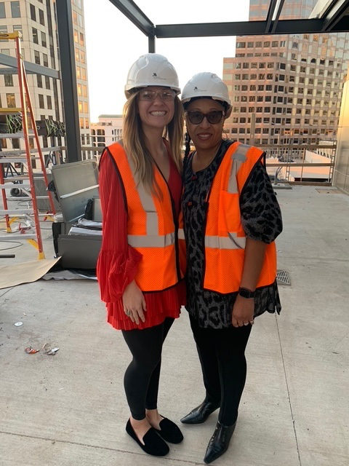
Let’s get to work…………..

Slide 16
The Work BEGINS……………
Once executed
Meet with the Builder / Superintendent
Set expectations on both ends
Purchase orders (POs) or no Pos
Scheduling (call, email, text, portal)
Lead times
Day of service window or by end of day
Dry runs (is there a back charge for dry runs)
No show (what happens if I no show)
All these items should be in the contract. Good general business practice to meet and set expectations!

Slide 17
Scope of Work (SOW)
What the contractor is expected to do!
The SOW or description of services lists the services that are to be provided according to the terms of the contract.
Listing the services clearly in the contract prevents uncertainty and helps to avoid disputes.
There should also be a clause that states what is not covered in the SOW.

Slide 18
Pay me NOW not later Fee structure and Payment plan
The payment clause should provide the following details
How much the payment is for the service being provided per the contract?
How the payment is to be made, and when the payment is due.
Payment is due upon delivery of service.
Payment is due within a certain number of days from delivery of service.
Payment is due monthly.
Are discounts allowed for early payments?
The payment clause should state the total amount that is due on the contract if applicable.

Slide 19
Pay me NOW part 2
Sometimes the payment is made based on milestones (this may apply in multi-family projects)
Milestones should be listed in sufficient detail to avoid confusion or disputes as to when a milestone has been reached.
Multi-family – completion of building
Other times the parties may agree that the payment will be made upon draws (apply to multi-family) in installment payments.
When installment payments (draw) are used, the payment provision should detail the frequency of the installment payments.
The due date of each payment and the amount due for each installment (draw).

Slide 20
Execution of the CONTRACT
Signatures
Be sure the right person (party) signs the contract.
Large Builder
Purchasing Agent
Custom Builder
Owner or Superintendent (does duper have authority)
Multi family
General Contractor (GC) or Purchasing Agent

Slide 21
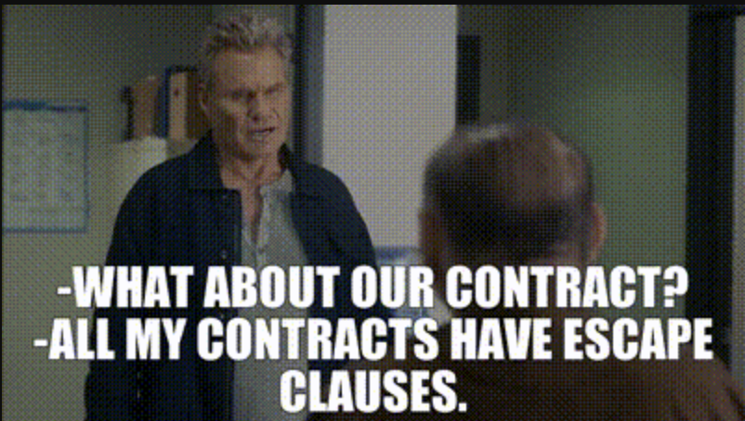
OTHER clauses in contracts the weeds
Insurance (what is required)
Taxes
Disputes
Warranties
Applicable state law
Etc.

Slide 22
Common Sense Contract Not a good contract
Relying solely on "common sense" is often insufficient as a defense.
What is common sense to one party may not be common sense to another party.
It is best to keep common sense out of the basis of contract negotiations.
Do not make judgments.
Let’s stay away from what seems reasonable or obvious.
Common sense for contractual matters can only be supported by evidence and facts.

Slide 23
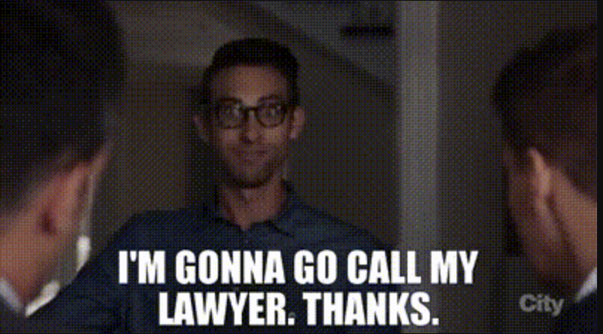
My best legal advice from a not Attorney!
You should always seek general legal council on all contracts.
If possible, contract with a qualified attorney or legal professional in your area.
Lean on a legal professional for all your contractual needs.

Slide 24
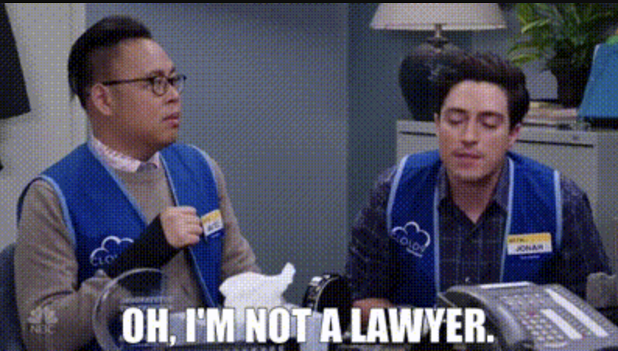
In conclusion – Guess What
I am not a lawyer. (disclaimer)
I have leaned on my days as an insulation contractor on what my best business contractual business practices were as a contractor.

Slide 25
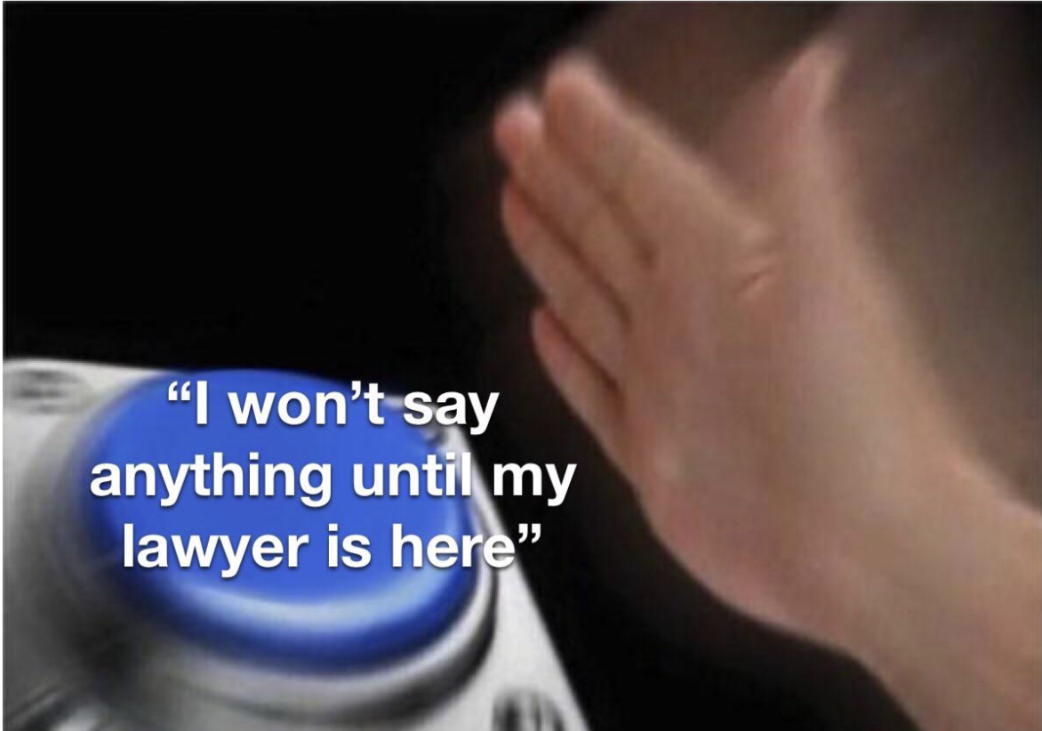
Contracts 101
Do not do this alone.
Seek local legal counsel for all contractual needs.
Protect yourself, your business and your employees
Thank you

Slide 26
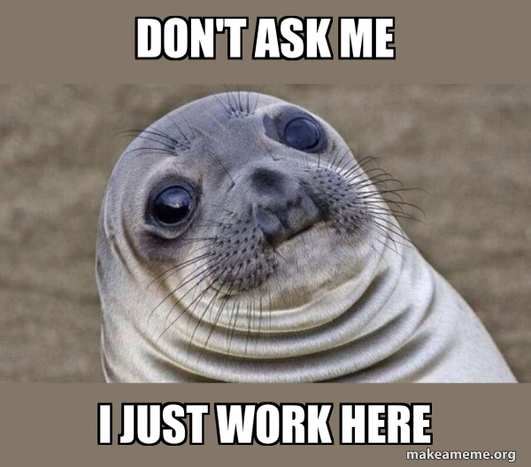
NO QUESTIONS BECAUSE I AM NOT AN ATTORNEY
Questions??????

